Slide 1
Online Patient Management System
A.Wahab(011193058)
All Tables:
…………………………..
Chamber
Payment
Method
History
Blood
Prescription
7. Carry
INSERT:
…………………………..
INSERT INTO carry VALUES ( '$cd', $pid,$dc)
INSERT INTO method VALUES ( NULL, '$mp', '$muf',$pid)
INSERT INTO chamber VALUES ( $cr,NULL, '$l','$at','$tn',$did,$pid)
INSERT INTO history VALUES ( '$r', '$vd','$vm','$vy',NULL,$pa,$pid)
INSERT INTO payment VALUES ( NULL, '$pd', '$oa','$na','$tp','$p','$un','$pt',$pid)
INSERT INTO prescription VALUES ( NULL, '$di','$m','$d',$did,$p)
INSERT INTO blood VALUES ( '$bg', '$qb',NULL,'$nod',$pid)
SELECT:
………………………………

Slide 2
SELECT * FROM carry;
SELECT * FROM method;
SELECT * FROM chamber;
SELECT* FROM history;
SELECT * FROM payment;
SELECT * FROM prescription;
SELECT * FROM blood;
DELETE:
……………………………..
DELETE FROM carry WHERE Patient_id =$Patient_id;
DELETE FROM method WHERE Method_Code=$Method_Code;
DELETE FROM chamber WHERE Chamber_no=$Chamber_no;
DELETE FROM history WHERE H_Code=$H_Code;
DELETE FROM payment WHERE Payment_id=$Payment_id;
DELETE FROM prescription WHERE Prescription_no=$Prescription_no;
DELETE FROM blood WHERE Donor_ID=$Donor_ID;
UPDATE:
…………………………….
UPDATE carry SET C_Days='$cd', Patient_id='$id', Diseases_Code='$dc' WHERE Patient_id = $id;
UPDATE method SET Method_Process='$mp', Method_Used_for='$mu', Payment_id='$pi' WHERE Method_Code= $id;
UPDATE chamber SET Chamber_Rent='$cr', location='$lo', Available_Time='$at', Telephone_no='$tn' , Doctor_id='$di' , PA_ID='$pi'
WHERE Chamber_no = $id;
UPDATE history SET Remarks='$r', V_Date='$vd', V_Month='$vm',V_Year='$vy', Patient_id='$pi', Payment_id='$pai' WHERE H_Code= $id;

Slide 3
UPDATE payment SET Payment_Date='$pd', Old_Amount='$oa', New_Amount='$na',Total_Payment='$tp', Paid='$p', Unpaid='$up', Payment_Time='$pt', Patient_id='$pi' WHERE Payment_id= $id;
UPDATE prescription SET Direction='$dir', Medicine='$me', Dose='$d',Doctor_id='$di', Patient_id='$pi' WHERE Prescription_no= $id;
UPDATE blood SET Blood_Group='$bg', Quantity_Blood='$qb', Number_of_donations='$nd', Patient_id='$pi' WHERE Donor_ID = $id;
AGGRIGATION:
……………………………………..
SELECT max(Chamber_Rent) c, SUM(Chamber_Rent) r from chamber;
SELECT COUNT(Method_Process) FROM method;
SUBQUERY:
……………………………………..
SELECT Available_Time,Telephone_no from chamber WHERE Chamber_Rent=(SELECT max(Chamber_Rent) from chamber); SELECT Blood_Group,Number_of_donations FROM blood WHERE Quantity_Blood>(SELECT MIN(Quantity_Blood) FROM blood);
JOIN QUERY:
………………………………………
SELECT
p.Payment_id,p.Total_Payment,p.Patient_id,h.H_Code from payment p JOIN history h USING(Payment_id);
SELECT pa.Email,p.Direction,p.Medicine FROM
prescription p JOIN patient pa USING(Patient_id);

Slide 4
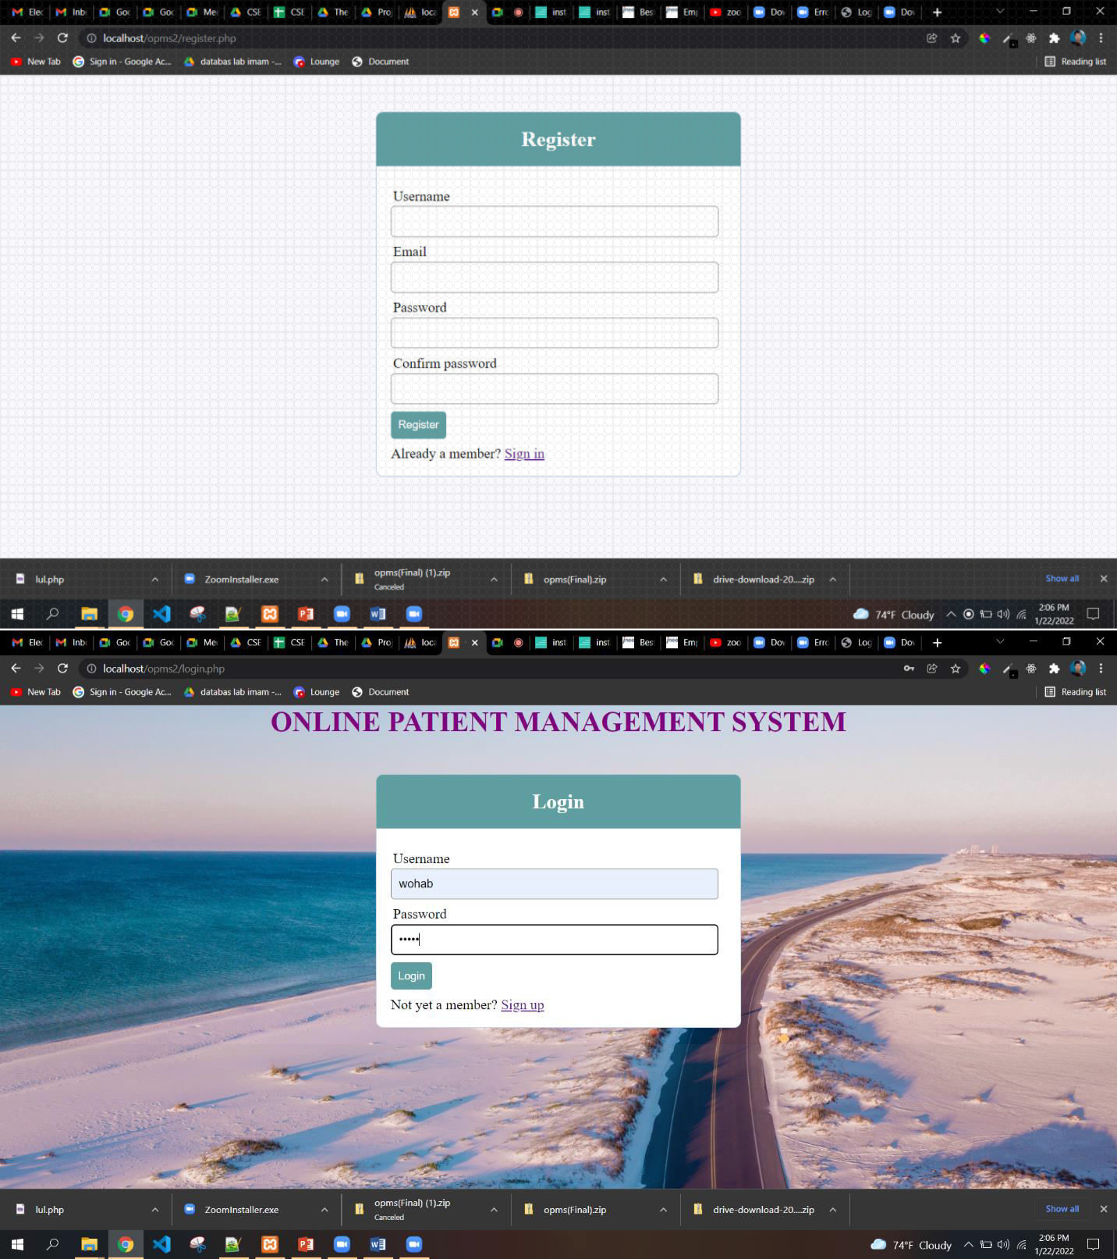

Slide 5
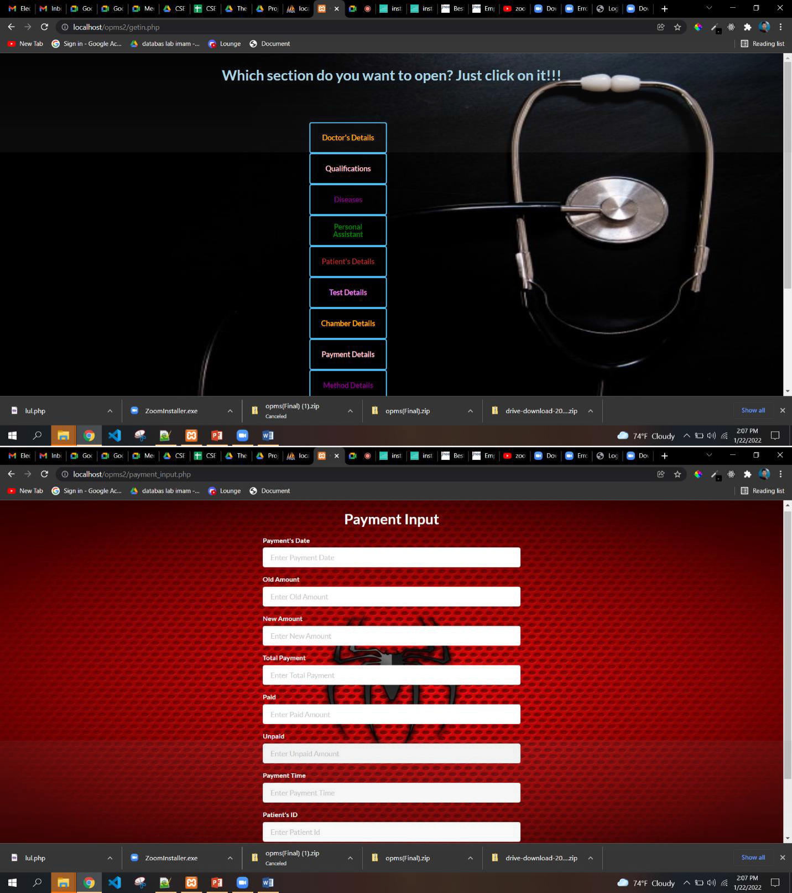

Slide 6


Slide 7
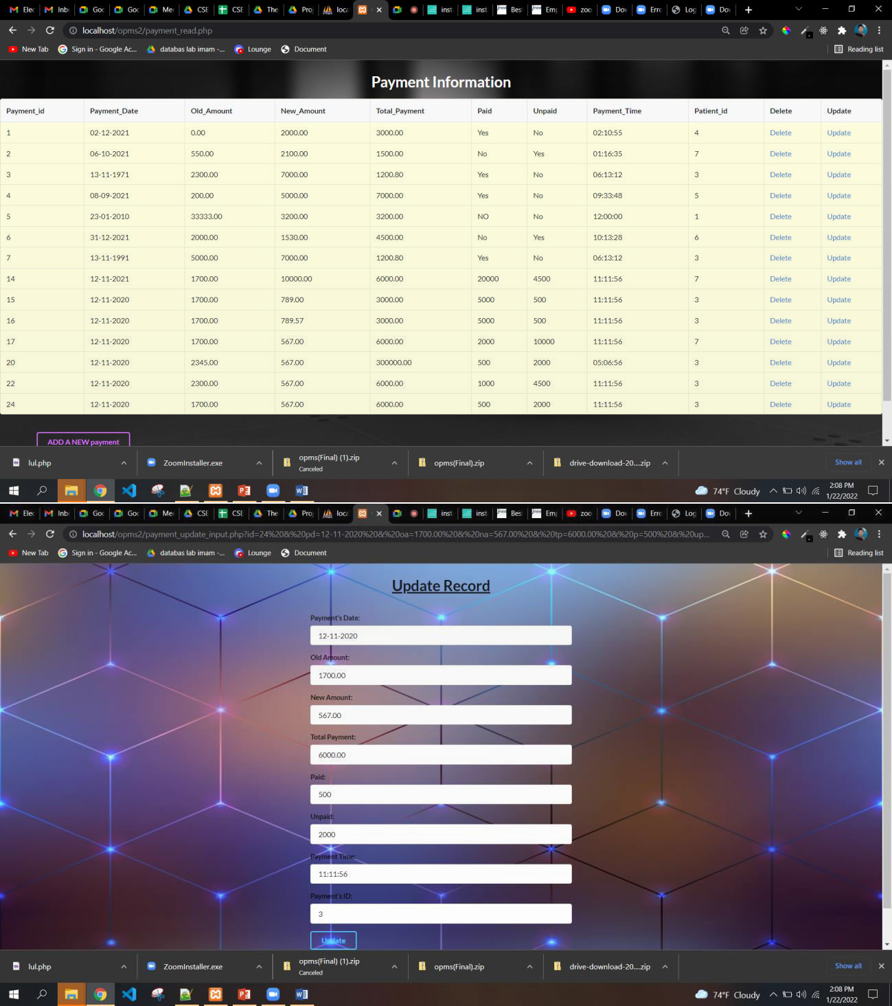

Slide 8
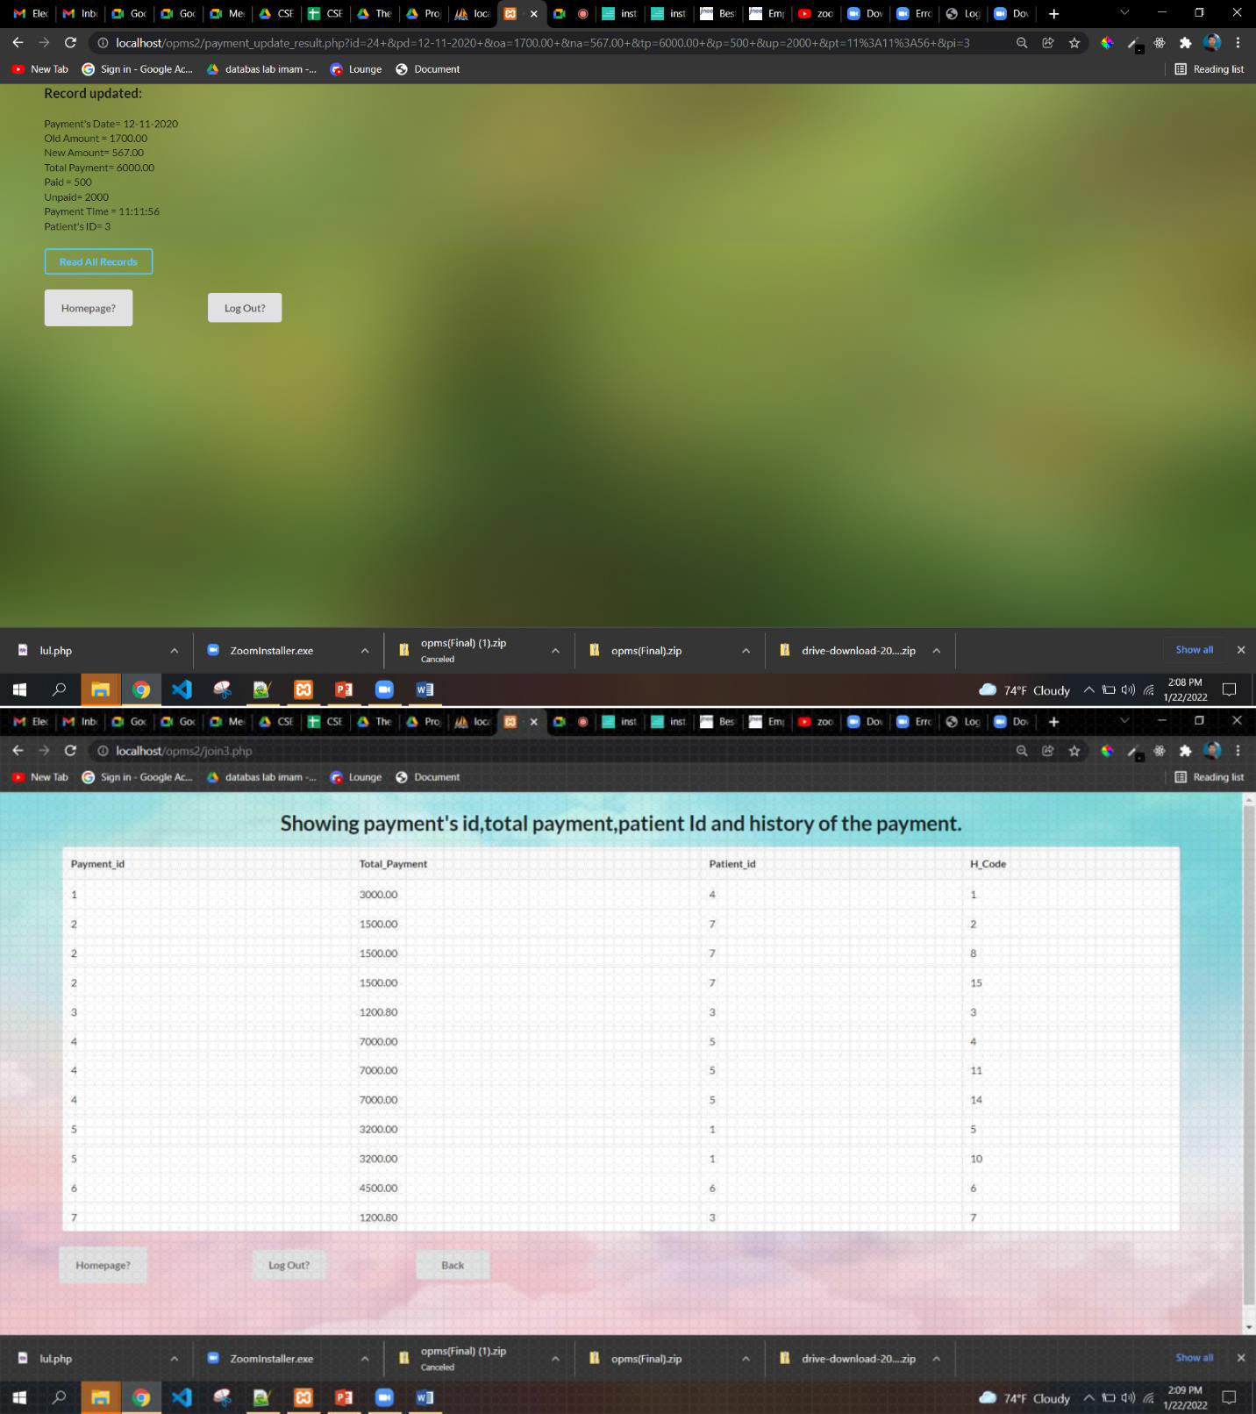

Slide 9
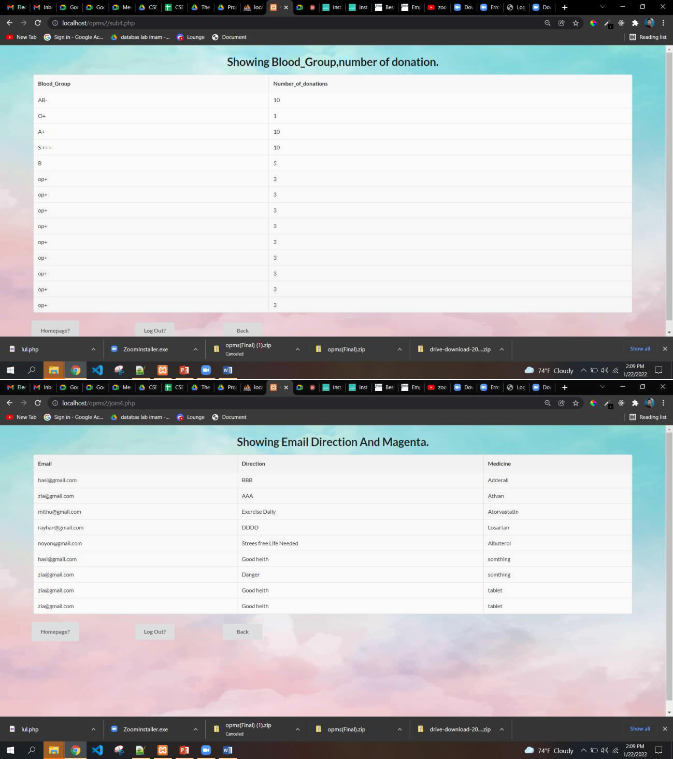

Slide 10
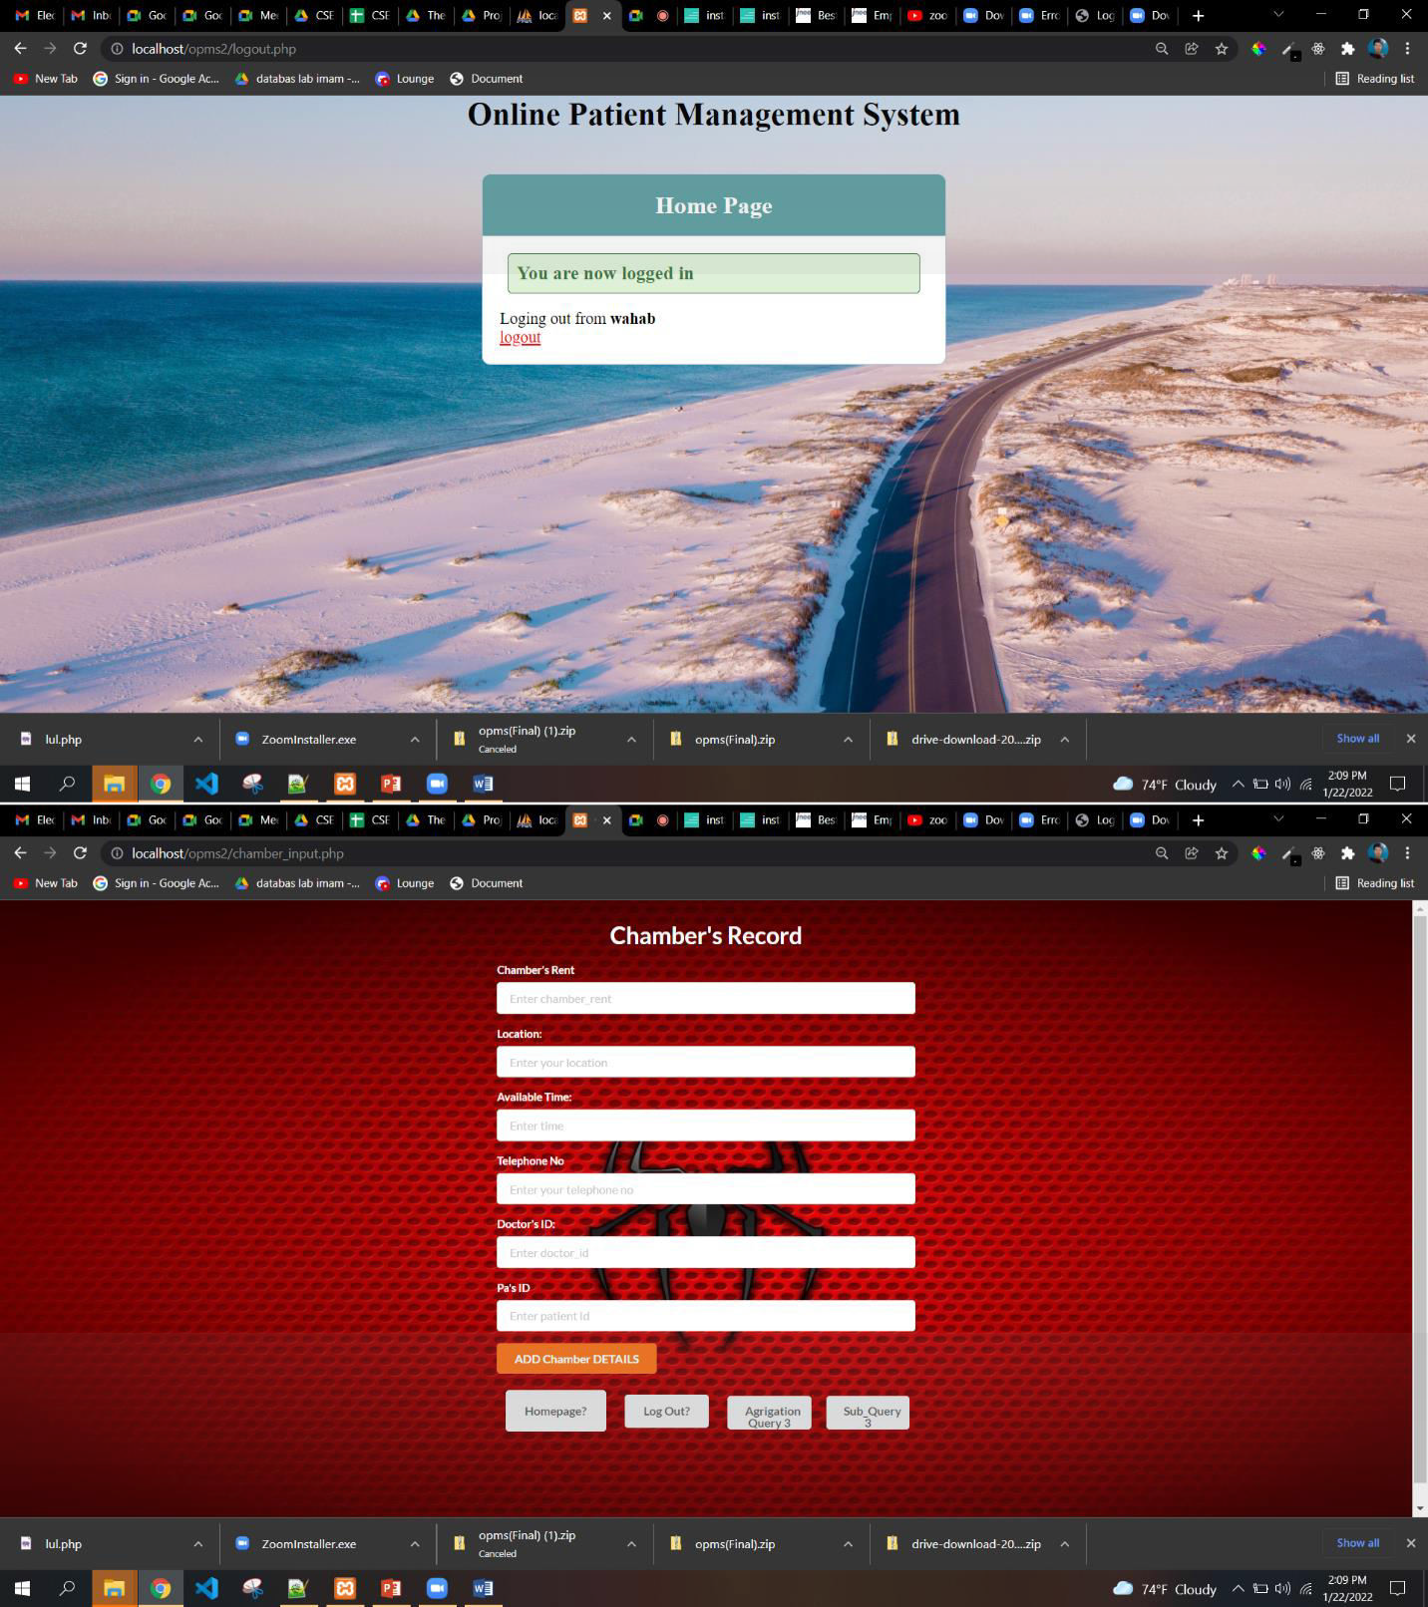

Slide 11


Slide 12


Slide 13
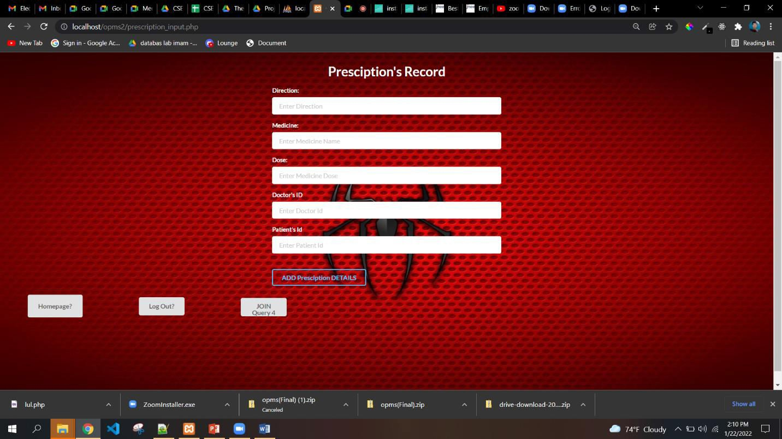
Feature:
…………..
1.Mobile Compatibility 2.Accessible to all user
Well Planned Information Architecture
Easy to log in, register and log out
Easy to delete, add, update, read any information
Fast Load Time
Well implementation of all queries( especially advanced queries)
Page Consistency
Designed Button
Good Error Handling

Slide 14
11. Attractive Background

